Slide 1
DevSecOps: Secure Cloud Enclaves
Sprint 5: April 11 - April 25
Ethan McIlhenny, Avantika Dasgupta, Josh Manning, Dharmit Dalvi

Slide 2

Recap
Create Secure Cloud Enclaves
Secure Object Storage
Extensive Logging
Key management and encryption
Rotating accounts and credentials
Notes:
We don’t have permissions to change/modify Keystone credentials. Also, MOC is moving away from keystone and more towards institution SSO
Logging all VM events

Slide 3
Recap
Sprints 1-2:
Learning OpenStack APIs
Creating Secure Buckets
Object Versioning, Disable Public Read/Write, Only allow SSL Requests
Sprints 3-4:
Logging and system security
Filebeat and Logstash
Fail2Ban
Openstack CLI Logging
Keys and Encryption
Barbican
At rest and in transit encryption
AUTOMATING!

Slide 4
Sprint 5 Work
Logging
Finish Configuration of Openstack CLI Logging
Write Cron Job to send logs to secure bucket
Object Storage API
Wrapper around S3 object storage API
Encrypt/decrypt objects
Generate logs for all bucket events
Keys and Encryption
Generate keys using Barbican
Store keys in Barbican
Scripting
Combine and logically organize scripts
Test Deployments on VMs

Slide 5

The Scripts
MasterScript_EnvironmentVars.sh
Adds key environment variables to be initialized on startup
MasterScript_Install.sh
Installs dependencies
Downloads scripts from GitHub
Creates original Openstack Tokens
Creates a dedicated log bucket
MasterScript_Config.sh
Loads in/Creates necessary configuration files
MasterScript_Launch.sh
Launches all services on the VM
Notes:
EC2 keys - set every time a user logs in
Openstack credentials - every time root logs in
Token - when the VM is created and the keys need to be generated

Slide 6
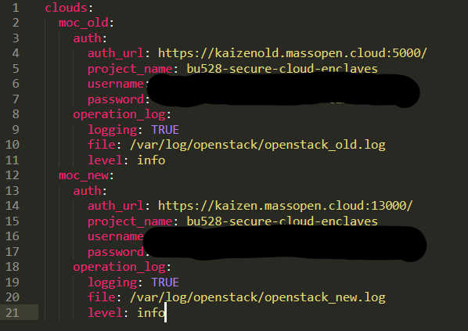
OpenStack CLI Logging
Why?
To get actual Openstack logs for creation of instances, images, networks, etc., would need to be MOC Admin
Proof of Concept
If can gather OpenStack Log events, can implement this configuration in own setup of Openstack in the backend

Slide 7




Last Sprint Architecture: Logging
VM
Service
Secure Object Storage
/var/log
/test_log

Slide 8
Architecture This Sprint
VM
Service
Secure Object Storage
log.cron
/var/log
/store_log

Slide 9
Log.cron
Cron Jobs
Specific command that you want to run on VM automatically
Added to cron tab →
In /etc/cron.hourly
Added a simple cron job that calls a python function to write logs to our bucket

Slide 10
Object Storage API
Functions:
List buckets
Create bucket
Delete bucket
List bucket versions
Upload to bucket
Download from bucket
Delete from bucket
Python script
Wrapper around the Ceph S3 API
Communicates with Barbican to fetch secrets (keys)
Encrypts/decrypts objects
Manually generates logs for all bucket events
Interactive CLI

Slide 11
Object Storage API - Automating Key Retrieval
Objects need to be encrypted before being sent to a bucket
Encryption keys aren’t locally stored → Barbican
Need to automate key retrieval - via Python script
Multiple storage locations (Kaizen URLs)
Pull the most recent
Pull the secret from there
Encrypt files on that secret
Store the key indefinitely on Barbican

Slide 12
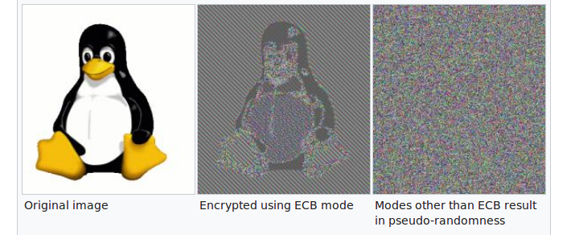
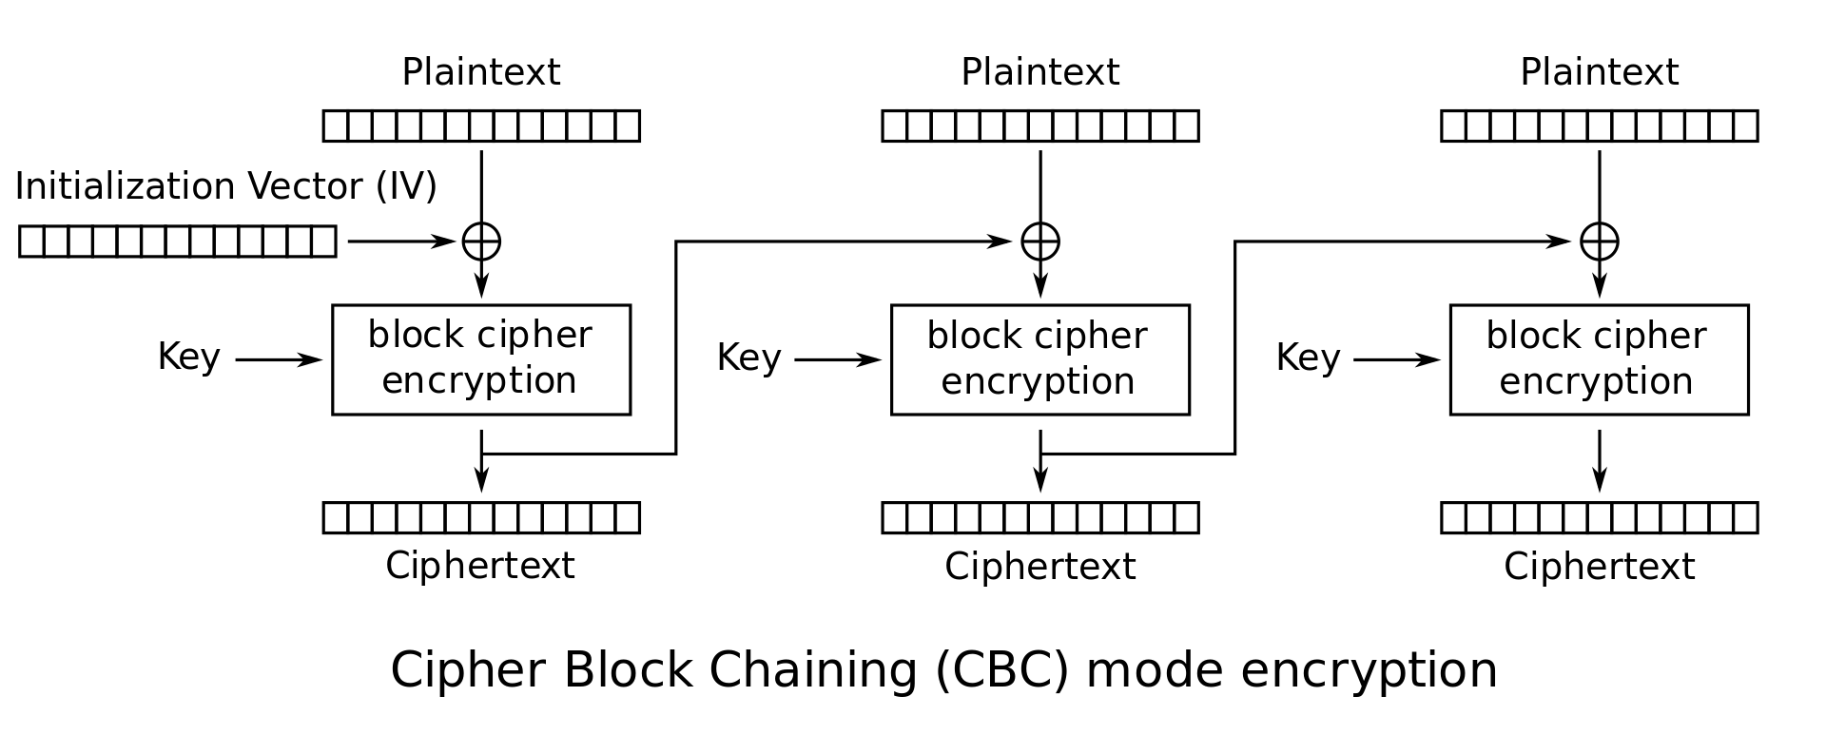
Encryption
Basic encryption: CBC-mode using pyCrypto
Python2 supported
Provides all the strong crypto needed
AES - Rijandael
CBC-mode
Encrypt files block by block this way
Block size of 65536

Slide 13
The Whole Picture
SETUP
Dependencies - installed every time a VM is created
Scripts - downloaded every time a VM is created
Config files - set every time a VM is created
Services - launched every time a VM is created
Object and log encryption keys - generated every time a VM is installed (don't expire so never change)
Environment variables
EC2 keys - set every time a user logs in
Openstack credentials - every time root logs in
Token - when the VM is created and the keys need to be generated

Slide 14
The Whole Picture [contd.]
FUNCTIONALITIES
Users can store sensitive data in S3 buckets
SECURITY FEATURES
All traffic (i.e. in transit data) is encrypted
VM events are logged
Services
Messages
Secure
Bucket events
Openstack events
IPs that do brute force attacks are banned
Secure object storage
Buckets are versioned
Objects are encrypted/decrypted
All bucket events are logged
Log file integrity
Logs can only be modified by root
Separate log bucket
Separate key for log encryption

Slide 15
DEMO

Slide 16
Future Work
Immediate
Fine tuning the scripts and launching on CONS3RT
Vulnerability scanning
To bring this to production
Java Workflows → direct integration into CONS3RT
Multi-User, Multi-VM sorting of logs → Into different buckets
Testing configurations in the backend of an Openstack Deployment
As an admin

Slide 17

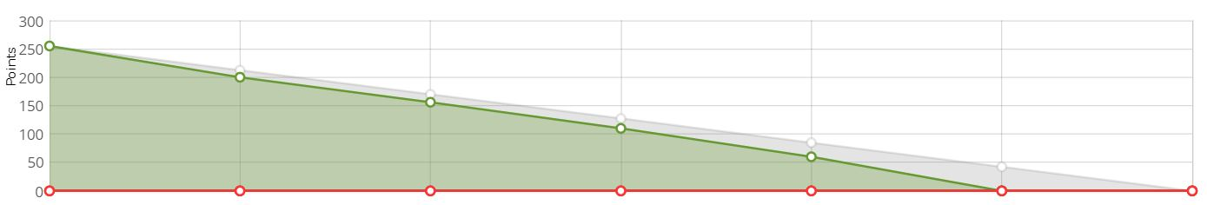
Sprint 5 Burndown

Slide 18
Questions?

